Slide 1
Chapter Seven
Lost Diver Search and Recovery

Slide 2
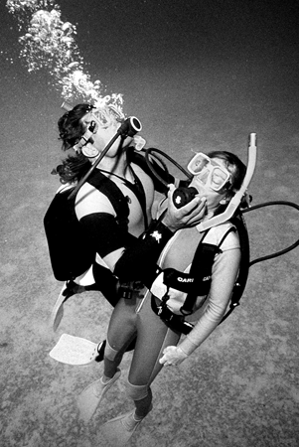
Topics In This Chapter
The Missing Diver
Organizing the Search
Search Patterns
Abandoning the Search
Assisting a Diver up to the Surface

Slide 3
The Missing Diver
Sometimes divers get separated
One diver may stop, or veer off, to look at something
One diver may be taking photographs
Divers may fail to maintain buddy contact
One diver may encounter a serious problem

Slide 4
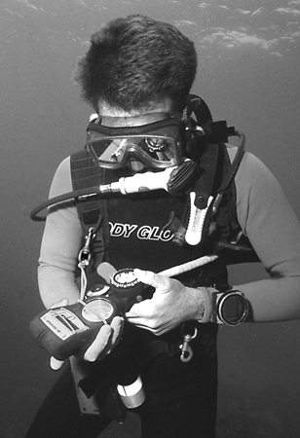
The Missing Diver
If a diver is missing for more than about
10 minutes . . .
Assume that there is a problem
Organize a search

Slide 5
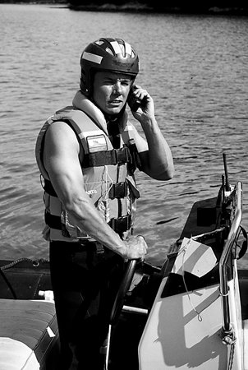
Organizing the Search
General consideration
A well thought-out and planned search will be most productive

Slide 6
Organizing the Search
Last known point
Where did the buddy separation occur, or where was it first noticed ?
Where did the other buddy surface ?
Did an observer notice bubbles, or anything unusual ?

Slide 7
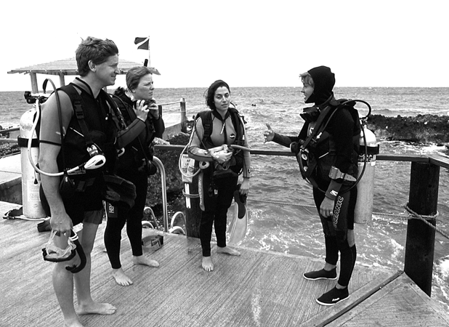
Organizing the Search
Gather information – interview buddy
Circumstances of the dive; anything unusual ?
How deep were they diving ?
How long had they been in the water ?
How much air did the lost buddy have ?
Might the buddy already have exited the water ?

Slide 8
Organizing the Search
Available personnel
Don’t attempt a solo search for your own buddy; note landmarks, and get help
Recruit available divers
Designate a team leader, who will coordinate from shore or boat
Team leader determines areas to be searched, and by whom
Do not allow persons to dive beyond their training and ability
Ensure that divers have sufficient air and allowable bottom time for search

Slide 9
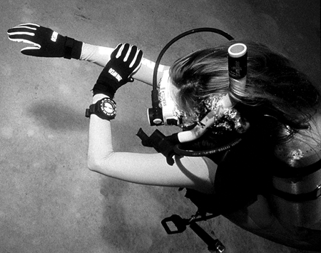
Organizing the Search
Search plan
Define the search area
If necessary, divide a bigger area into easily searched portions
Designate a well-marked starting point
Determine a stop point, in advance

Slide 10
Search Patterns
Circular search
Using a tethered line, the diver swims a circle around a fixed point
The distance is extended from the fixed point on each revolution
The maximum distance, from the fixed point, is 30 metres / 100 feet
Then move to another fixed point, allowing patterns to overlap

Slide 11
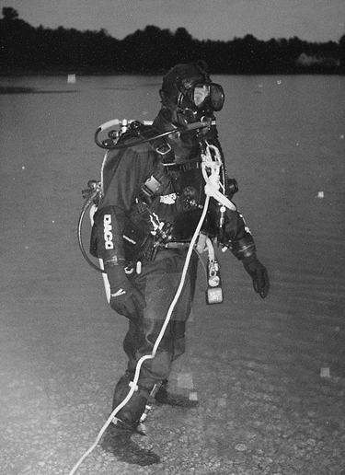
Search Patterns
Sweep search
Tender, on boat or shore, directs search pattern
Using a tethered line, the diver swims back and forth in an arc
The tender extends the distance on each arc
The maximum distance, for the tethered line, is 30 metres / 100 feet

Slide 12
Search Patterns
Random search
Useful along shorelines with rocky outcrops and coves, where there are underwater crevices and overhangs, or where swaying kelp is an issue
Competent free-swimming divers may be employed for these areas
An observer should be assigned, to watch from shore or boat

Slide 13
Abandoning the Search
After about 90 minutes, survival is unlikely
Do not endanger other divers by continuing a futile effort
Public safety / emergency response dive teams are in a better position to make the recovery

Slide 14
Assisting a Diver up to the Surface
Upon making contact with a missing or
distressed diver . . .
First determine what the problem is
Do not rush into a situation you don’t understand
The correct response will vary, depending on whether the diver is conscious or unconscious

Slide 15
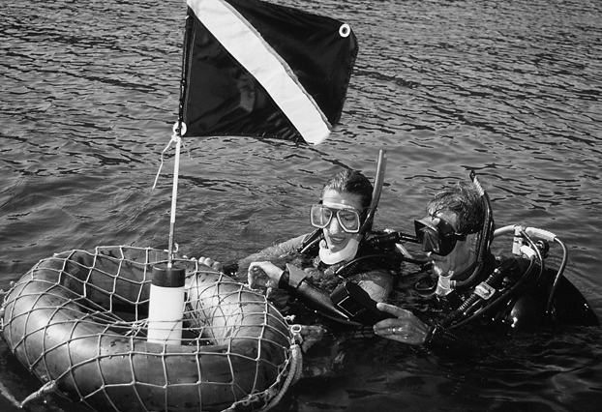
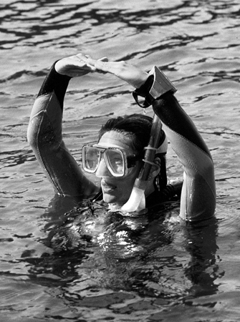
Assisting a Diver up to the Surface
Conscious diver
Establish contact while out of arm’s reach
Signaling “OK” should provoke some response, and diver may identify the problem
Before attempting to render assistance, signal your intentions

Slide 16
Assisting a Diver up to the Surface
Ascending with the conscious diver
Signal the diver to calm down and take a couple of deep breaths
Move so that diver sees your approach
Gently and firmly grasp diver under his arm
Signal to ascend
Monitor diver and communicate frequently
If diver fails to vent air from BC, you may need to do it for him
Ascend at as normal a rate as possible
Establish positive buoyancy at surface

Slide 17
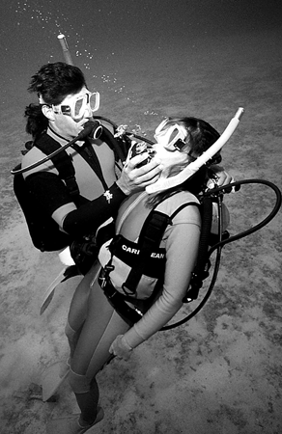
Assisting a Diver up to the Surface
Unconscious diver
If there is no response from diver, start immediate ascent
Ensure that the victim’s regulator stays in place
If diver is not breathing, there is no risk of lung expansion injury
Vent air from both BC’s during ascent
Ascend at as normal a rate as possible
Establish positive buoyancy on surface

Slide 18
Summary
In the event of a lost diver
After about 10 minutes assume there’s a problem
Organize a search
Get the victim to the surface
Assess victim and administer appropriate care

Slide 19
Scuba I.Q. Review

Slide 20
Scuba IQ Review
1
Q
What kinds of information do we need to gather to plan an underwater search?
A
The last known point and where the buddy surfaced; the circumstances of the dive; how deep they were diving; how long they had been in the water; and how much air the lost diver had left in his tank

Slide 21
Scuba IQ Review
2
Q
List the three major components in any underwater search pattern.
A
Define a search area
Define a start point
Define a stop point

Slide 22
Scuba IQ Review
3
Q
When might we use free-swimming divers to conduct random searches?
A
Along shorelines where there are many rocky outcrops and coves, or where underwater there are crevices and overhangs, or anywhere kelp is long and subject to swaying from the surge

Slide 23
Scuba IQ Review
4
Q
How would you bring a conscious, but confused diver to the surface?
A
Signal the diver OK, slow down and take a couple of breaths to relax; approach the diver, then gently and firmly grasp him under the arm while signaling to ascent with your other hand; if he fails to vent his BC you’ll have to do this for him as well as yourself; maintain control and continue to signal the diver to relax and breathe normally; monitor the diver constantly and communicate with him frequently; ascend at as normal a rate as possible by using good buoyancy control

Slide 24
Scuba IQ Review
5
Q
If the diver is breathing, but unresponsive on the bottom, what would our main concern be as we bring him to the surface?
A
To make sure the victim’s regulator stays in place during the ascent

Slide 25
Scuba IQ Review
6
Q
Why is a lung over-expansion injury not a serious consideration when bringing an unconscious, non-breathing victim to the surface?
A
An unconscious person is not holding his breath, thus the expanding air will vent on ascent

Slide 26
Any Questions ?

